Slide 1

Liquid Propellent Engine:
Test Stand Integration and Testing
Bert DeChant
Jacob Tiller
Eric Thomas
Sam Hasting Hauss
Matthew Ng
Peter Mazhnikov
Erik Potenza
Notes:
Created 15 Oct 17

Slide 2

Agenda
Project motivation
Requirements and Test Hardware
Status of primary requirements
Test Stand
Pintle Injector
Location suggestions
Engine
Questions

Slide 3
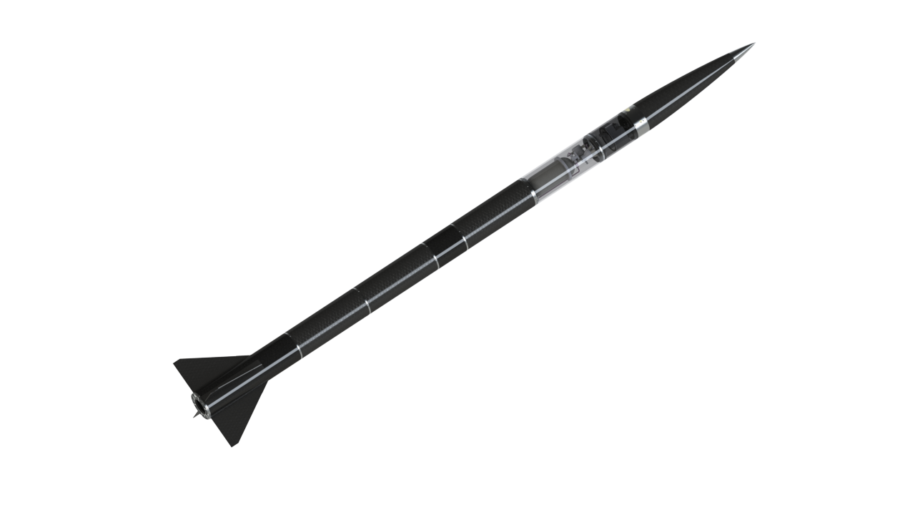
Project Motivation
PSAS Joined the Base 11 Space Challenge
University Xprize for Liquid Bipropellant rocket to 100km
Provides training modules, resources, and industry connections
PSAS already planned to construct a 100km design
PSAS Technologies have 100km in mind
Electric Feed System
Electronic Nose Separation (recovery system)
Cryogenic Carbon Fiber Propellant Tanks
Carbon Fiber Airframe
Cold Gas Reaction Control
Liquid Fueled Rocket Engine
Liquid Propellant Test Stand

Slide 4
Project Requirements
Test the engine and injector hardware provided by PSAS
Physical Construction of the Test Stand
Data and Analysis from engine and hardware tests
Documentation

Slide 5
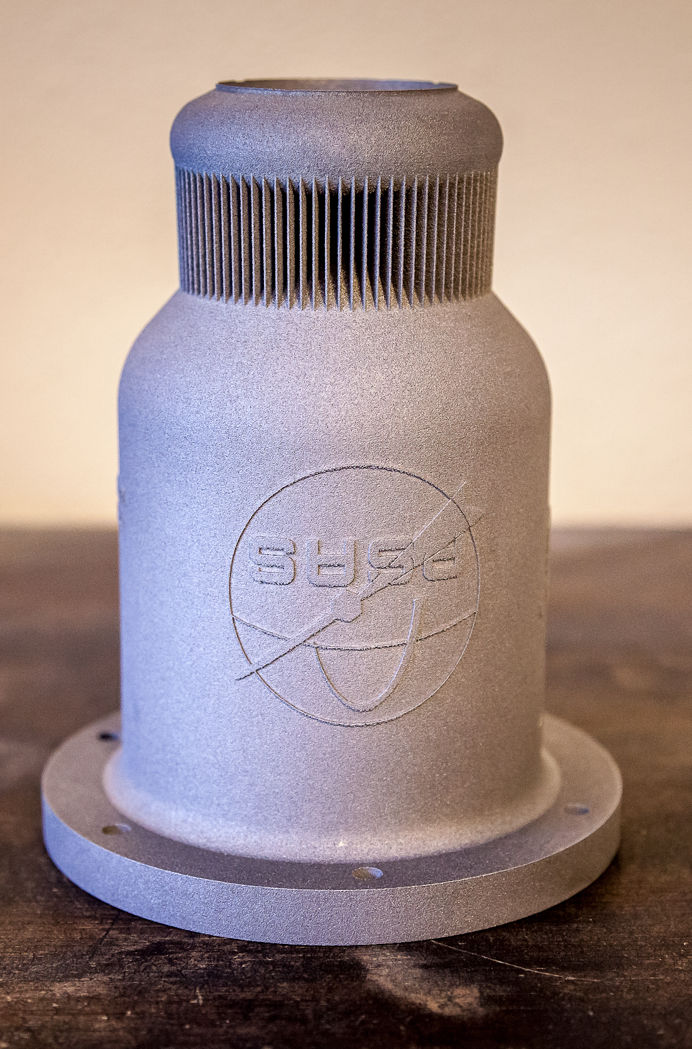
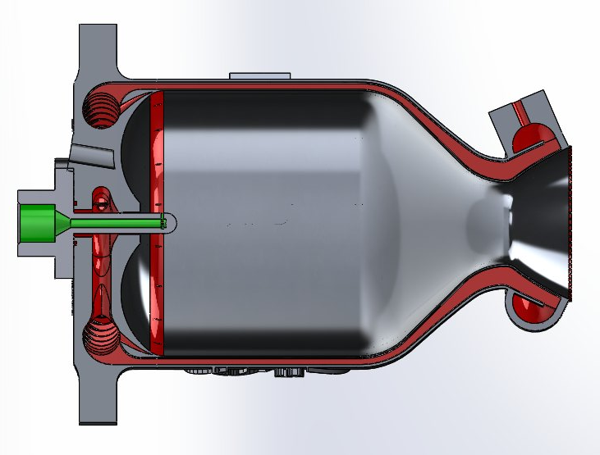
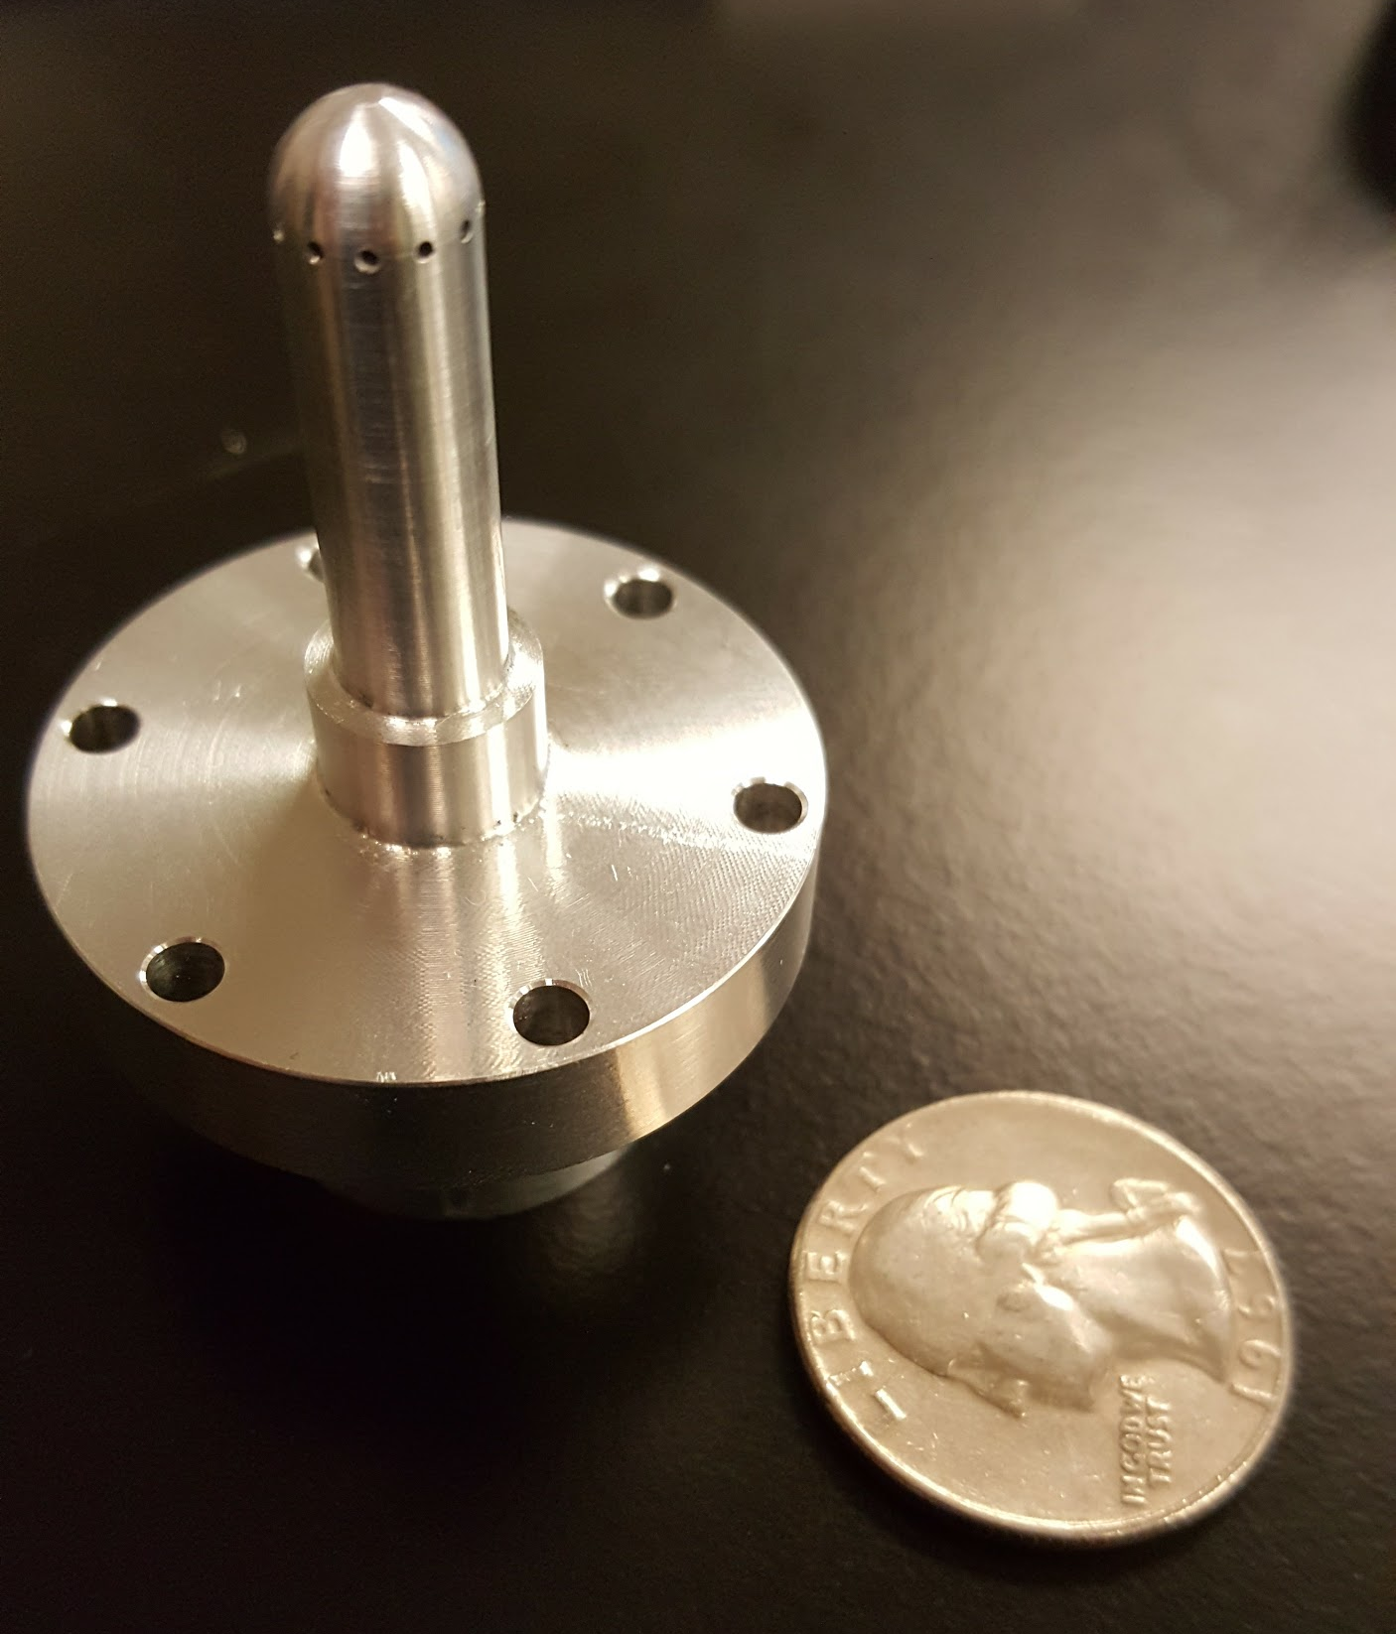
Hardware:
Engine and Injector
2.2 kN thrust ground-test engine
LOX + Isopropyl alcohol (IPA)
Regeneratively cooled combustion chamber
Metal 3D-printed AlSi10Mg
Pintle Type Injector
LOX centered injector design

Slide 6
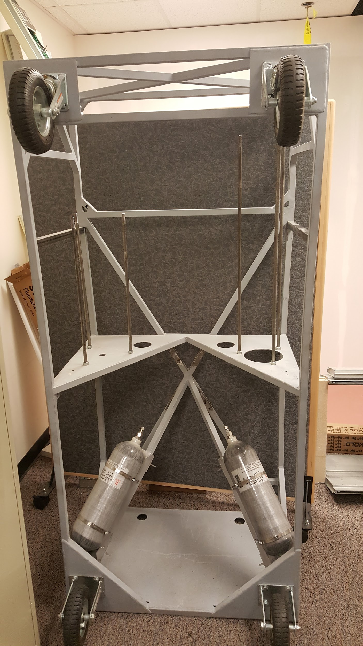
Hardware:
Test Stand Frame
Test Stand frame completed by prior capstone
Designed for up to 10kN (2250lbf) of engine thrust
Propellant tanks provided
Did not match the CAD due to manufacturing errors

Slide 7
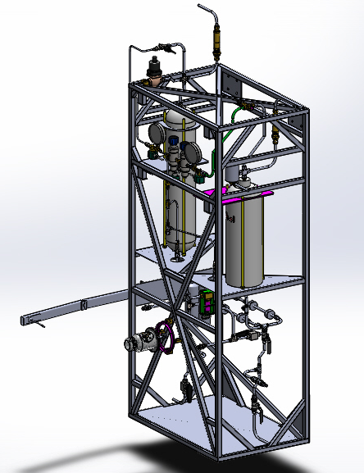
Test Stand Progress
Requirement:
Construction completed
Status:
CAD Piping layout complete with all major fluids components
Stainless Steel tube and drawings sent off for bending
Fuel plumbing installed
Igniter, Pressure Releif Valves, LOX side plumbing awaiting delivery.

Slide 8
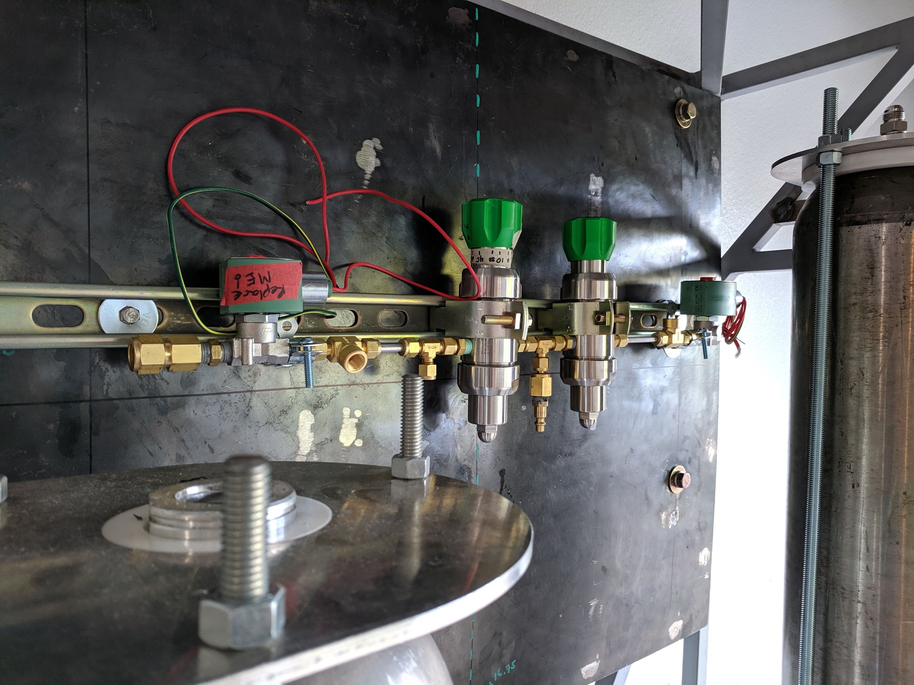
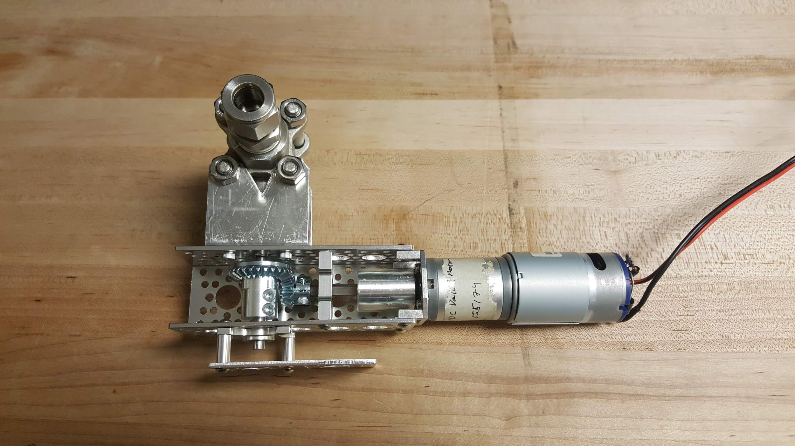
Test Stand Progress
Temporary hardware in place
Pressure control valves supplied are insufficient
Completion pending LOX plumbing and firewall materials
Sections are now modular by material with AN/JIC fittings to increase maintainability

Slide 9
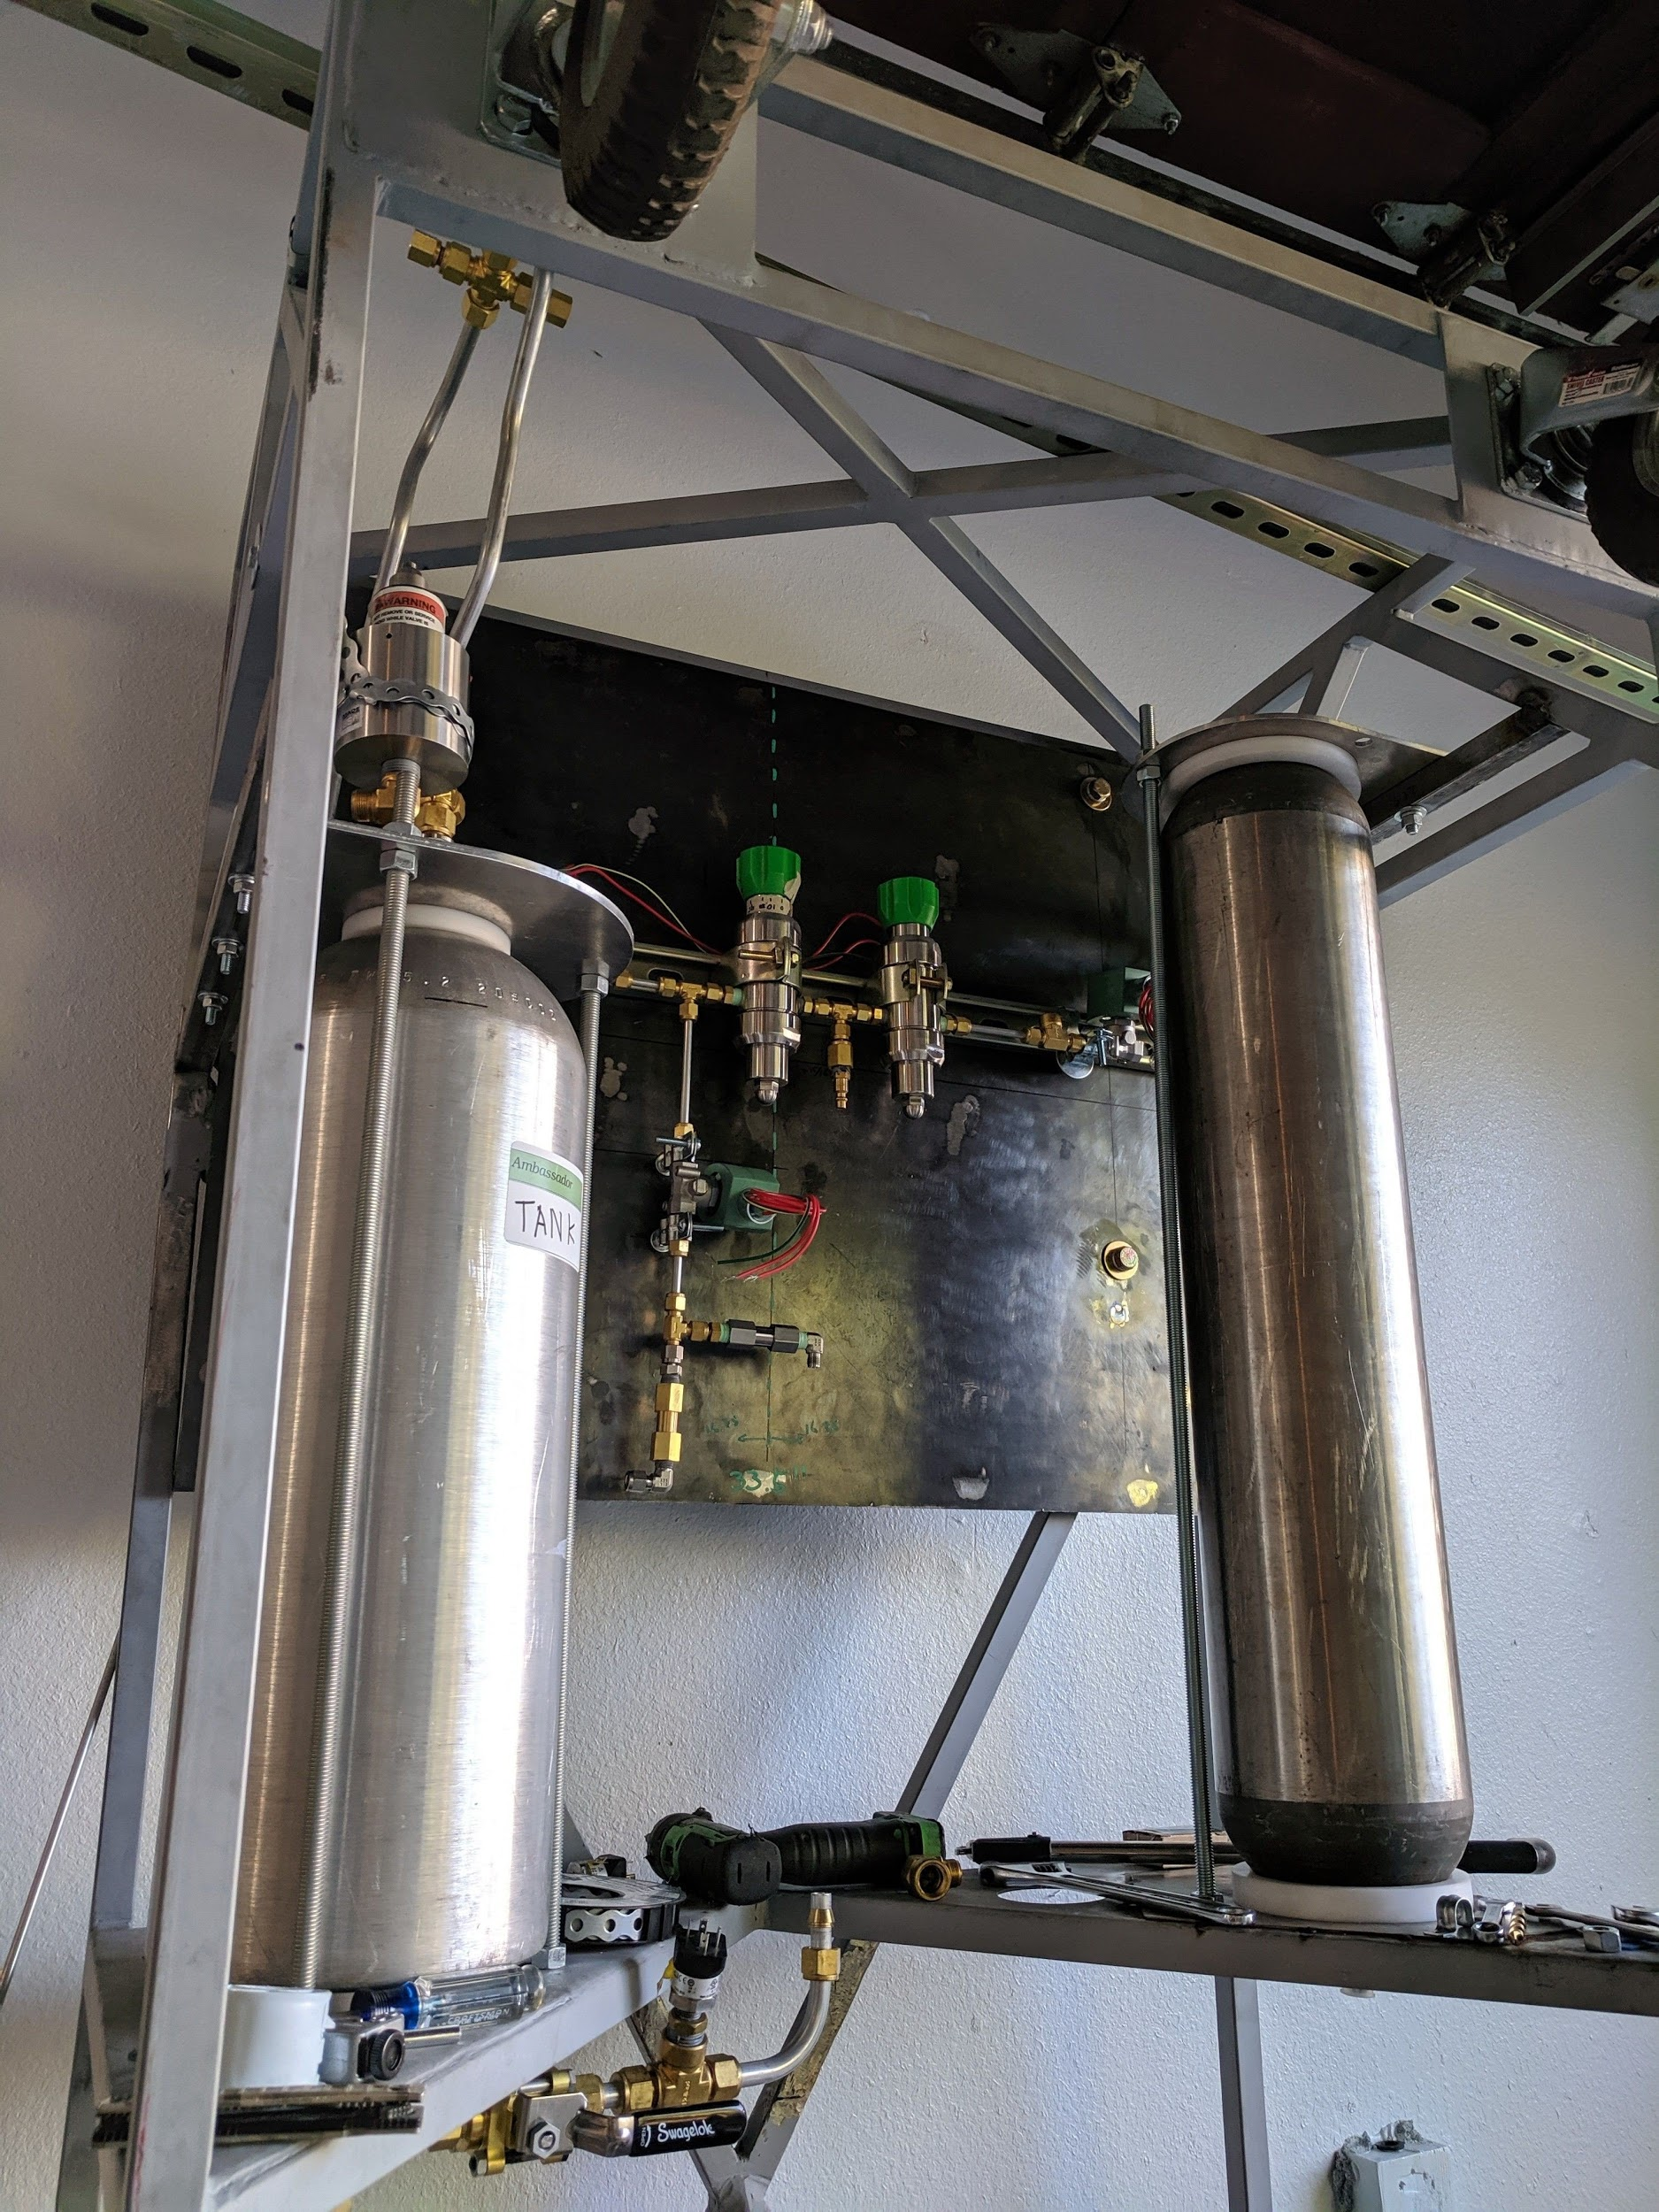
Test Stand Progress
Main Fuel Valve (Servo) designed and prototyped
Prototype Workin, waiting on programming
Will be final version
LOX side needs duplication and new brackets.
Spark-Torch igniter and swing-arm
Went with an external ignition
Arm pulls igniter away from exhaust
Held by electromagnet

Slide 10
Testing:
Pintle Type Injector
Requirement
Test Provided Pintle Injector
Design requirements:
Mass Flow Rate:
LOX - 0.405 kg/s
70% IPA - 0.526 kg/s
Pressure drop of 15-25 % of chamber pressure
345-485 kPa (53-88 psi)

Slide 11
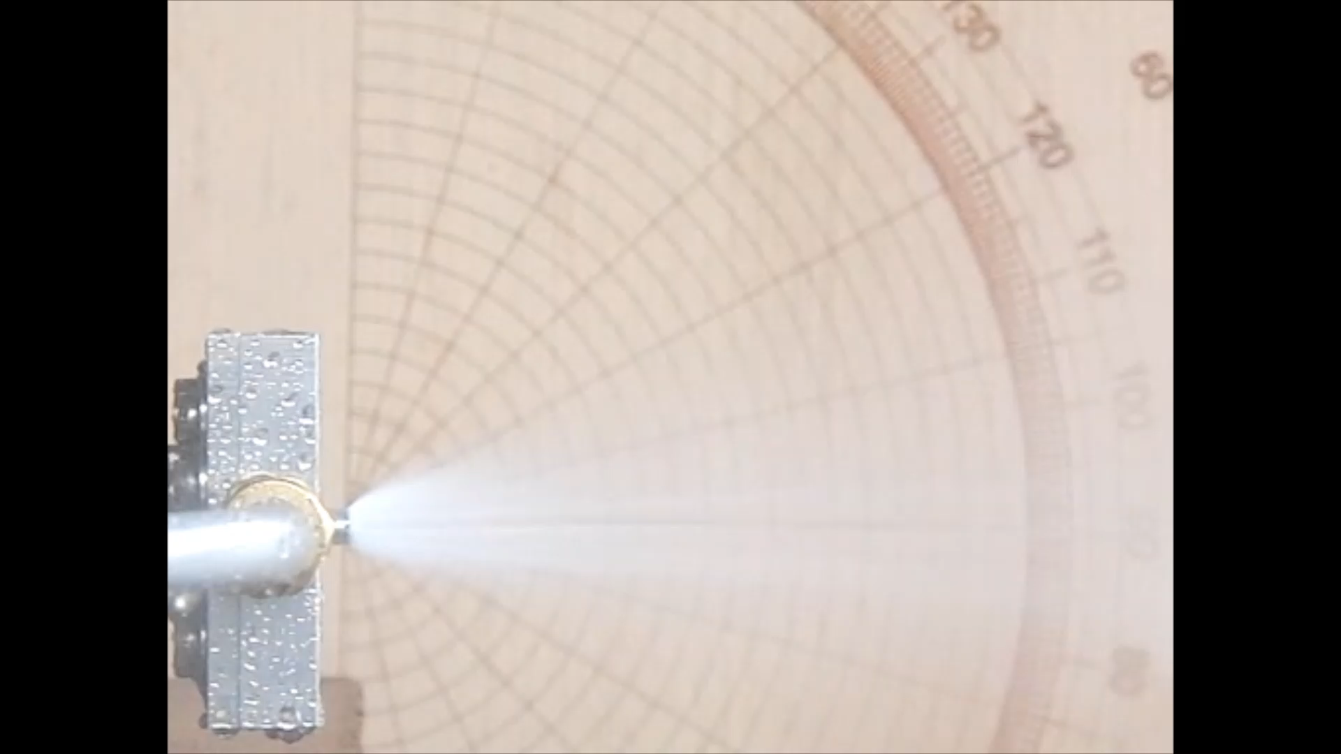
Pintle Injector:
V1 Hydro Testing

Slide 12
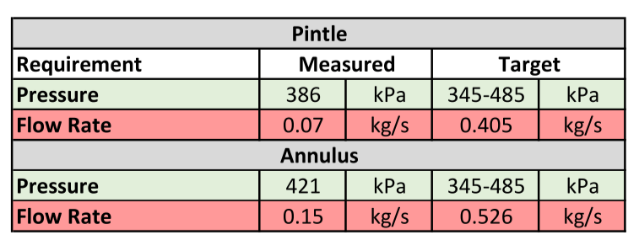
Initial Testing Results
Required volume flow rate ~ 67 liters / min (15 gpm)
Measured flow rate ~ 16 liters / min (3 gpm)

Slide 13
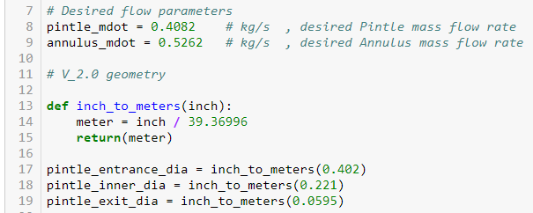
Injector Redesign
Hand calculations starting from energy equation
Python Design tool created in Jupyter notebook
Inputs
Fluid (Water, LOX, IPA)
Mass Flow Rate
Orifice sizes
flow geometry size
Outputs
Estimated head loss
Estimated head loss coefficient
Exit velocity, Reynolds number…

Slide 14
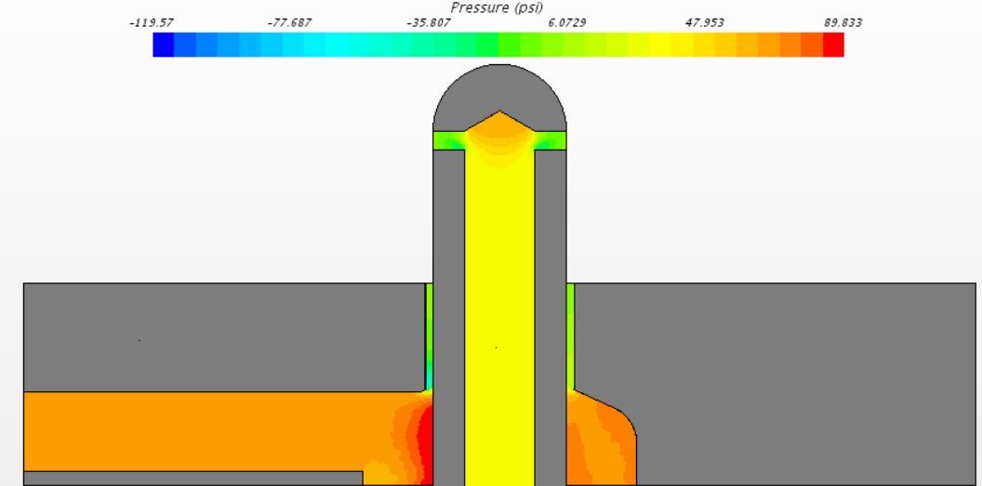
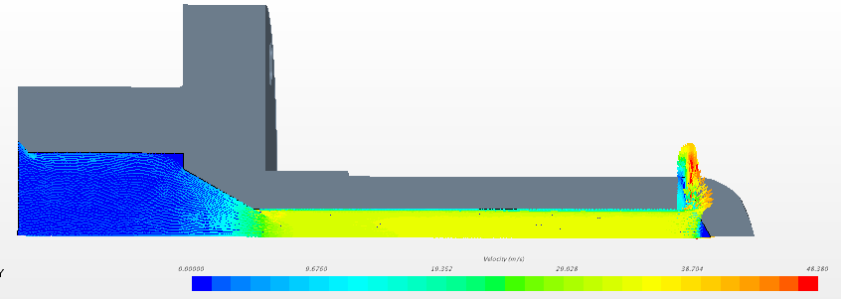
CFD Model
Current CFD Model
Parametric design of all flow geometry
Initial simulations focused on head loss and exit velocity for water

Slide 15
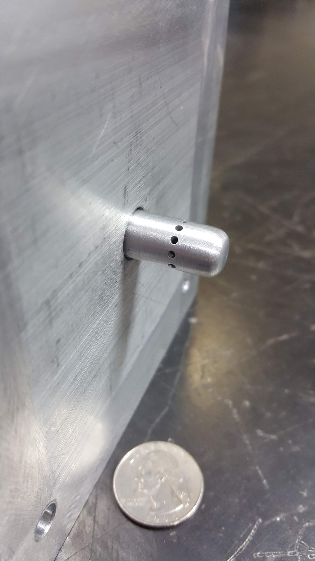
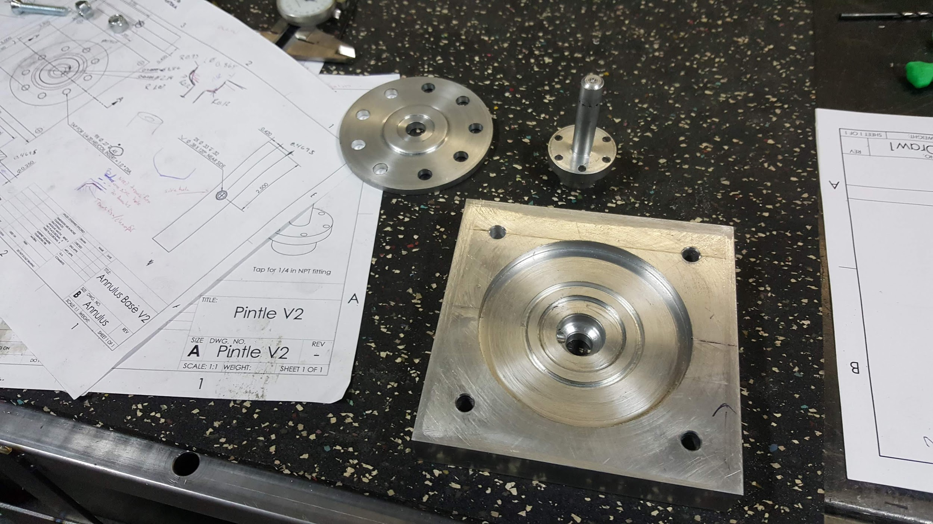
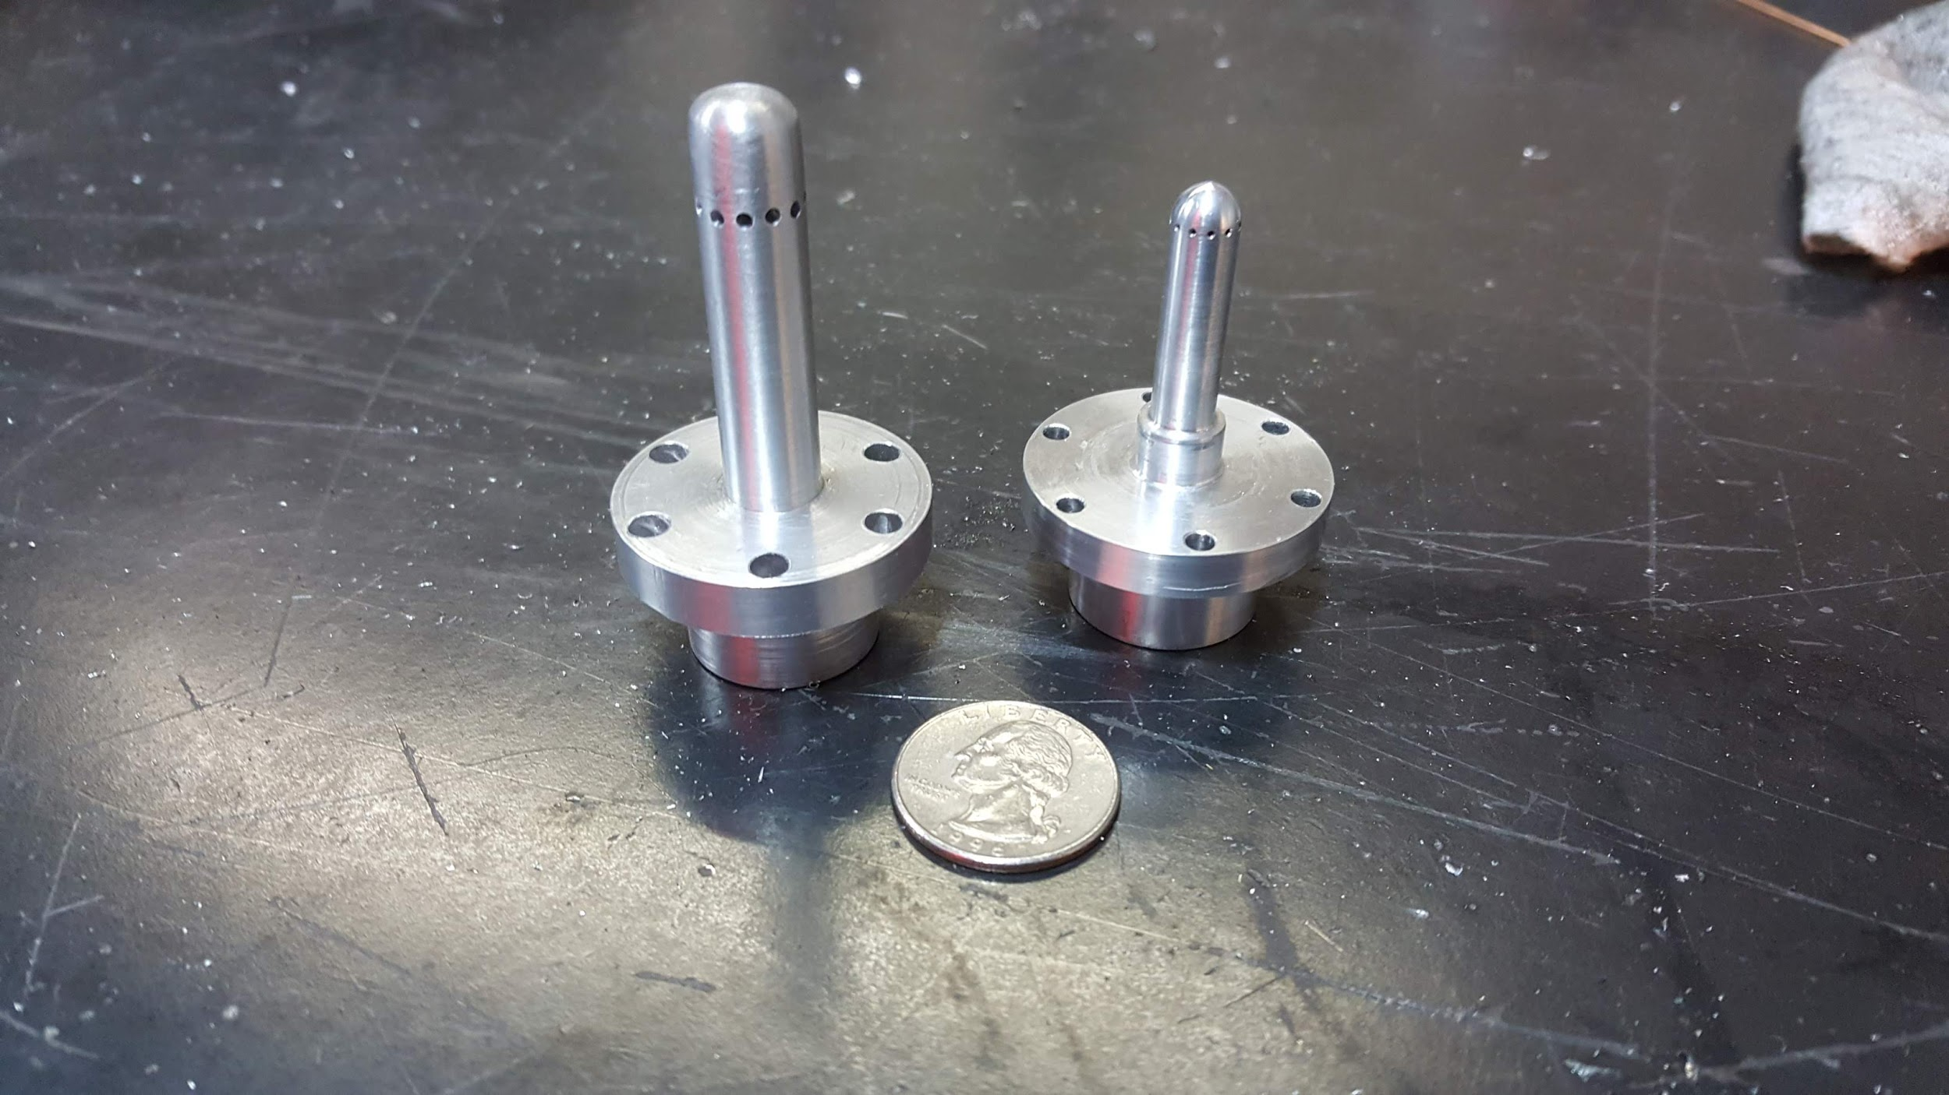
Pintle V2
Initial design machined out of 6061 Al for hydro testing

Slide 16
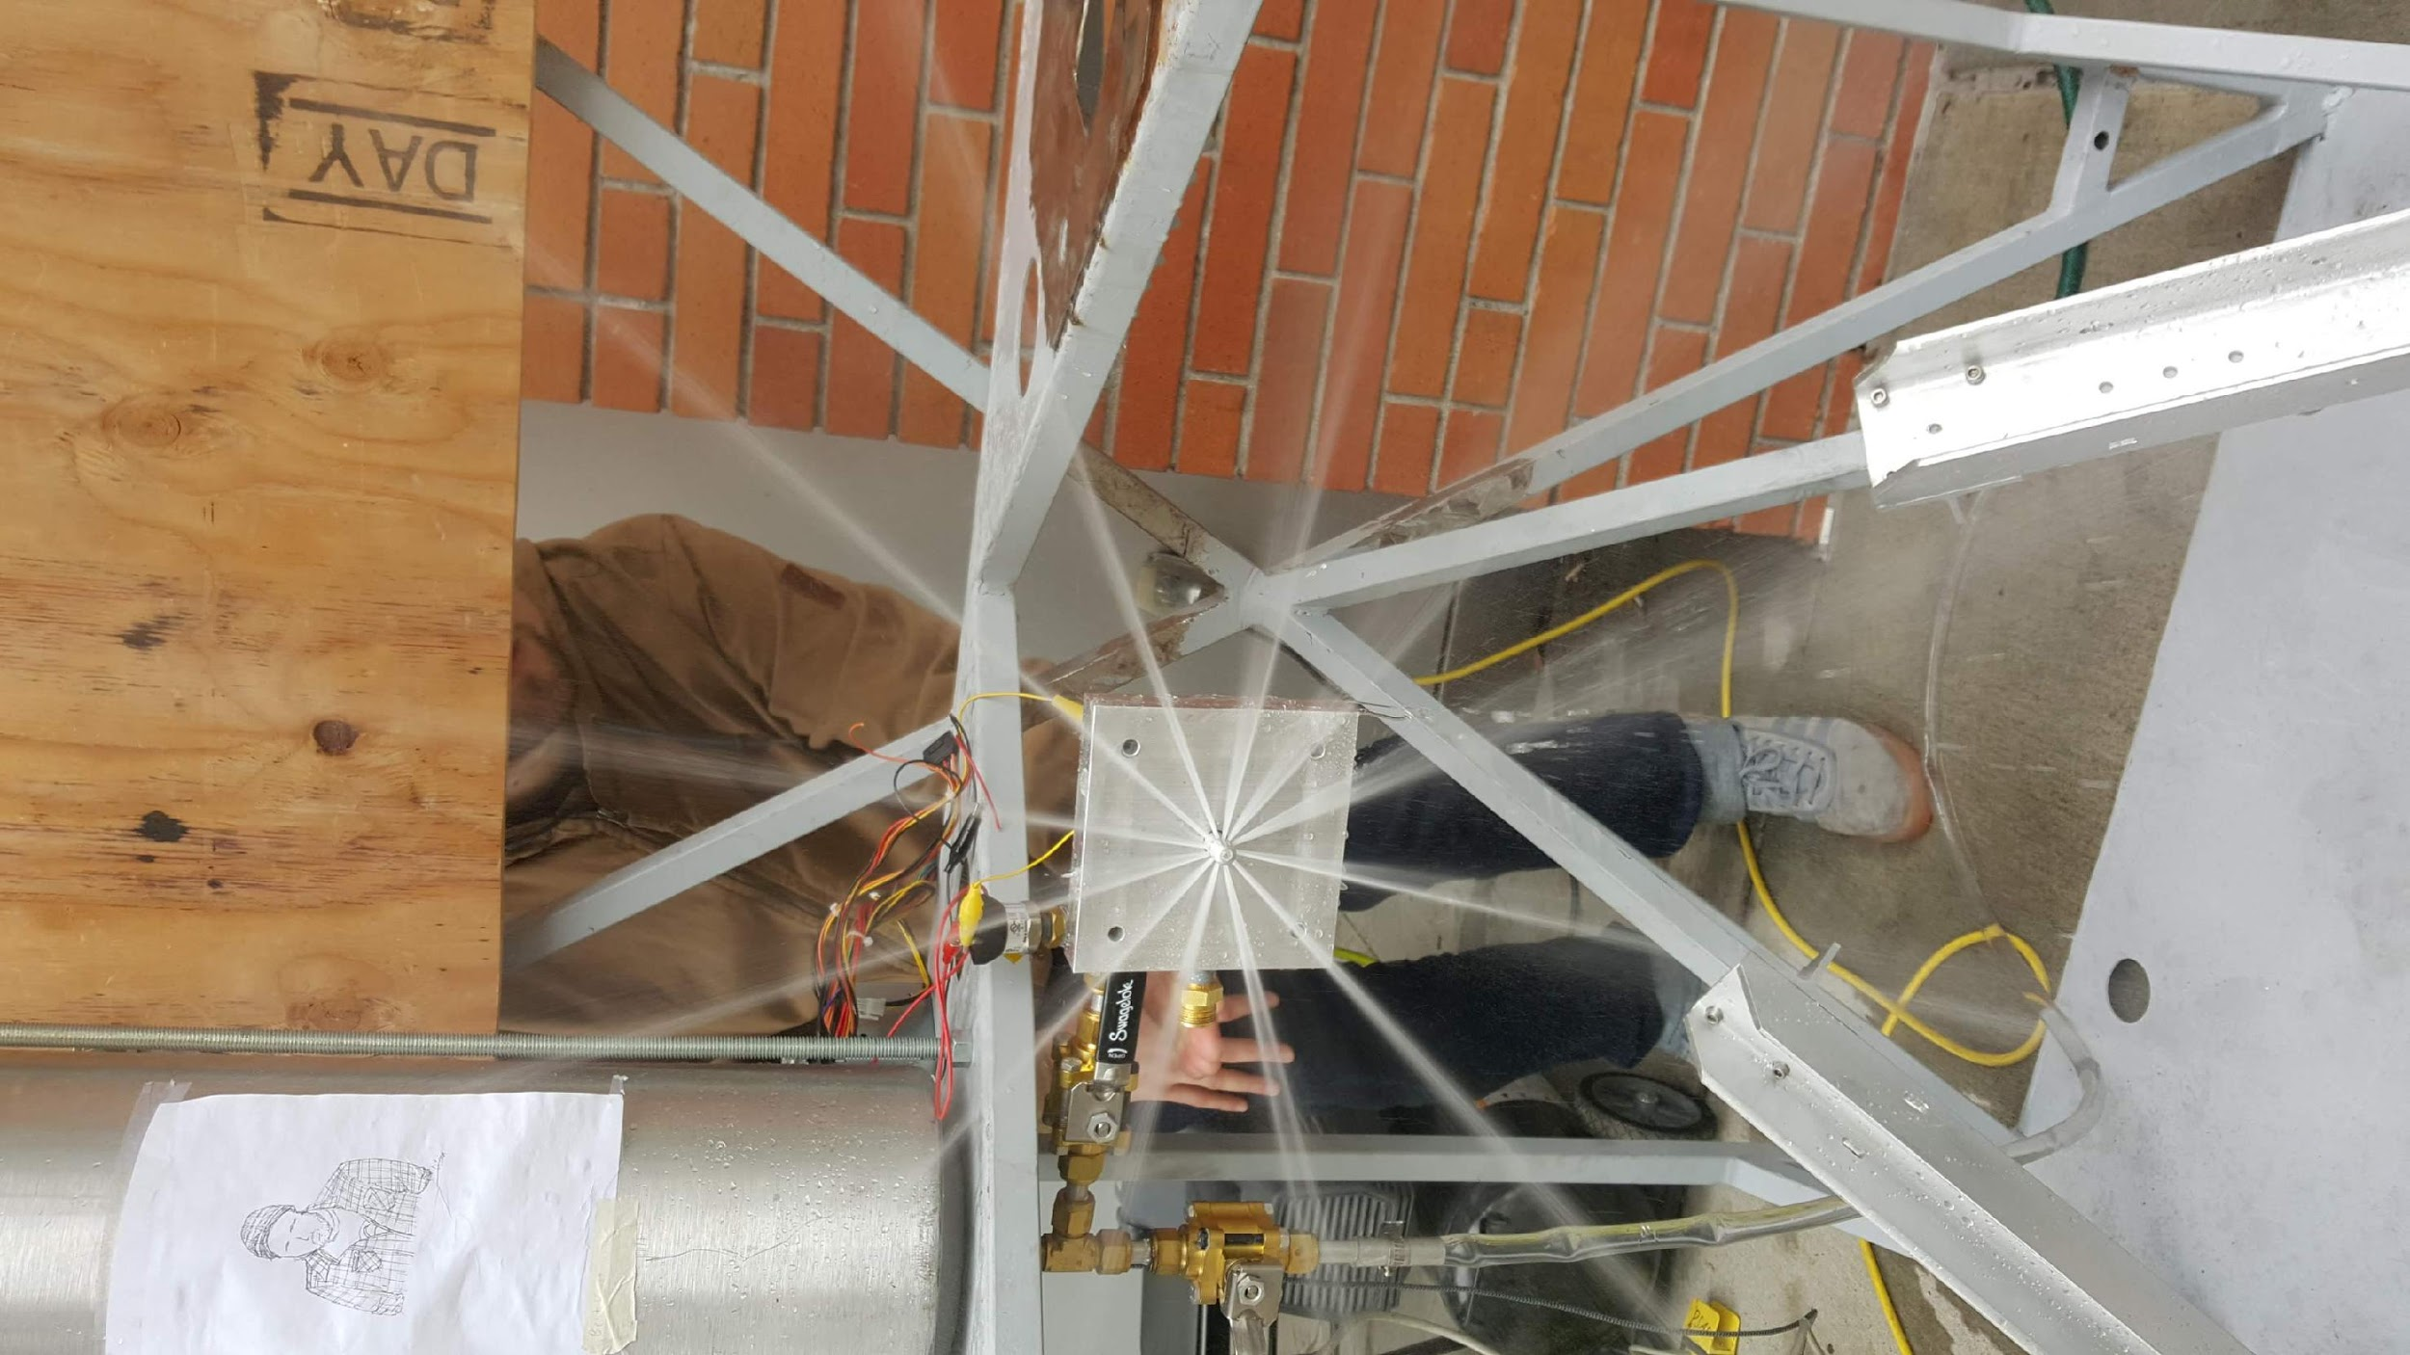
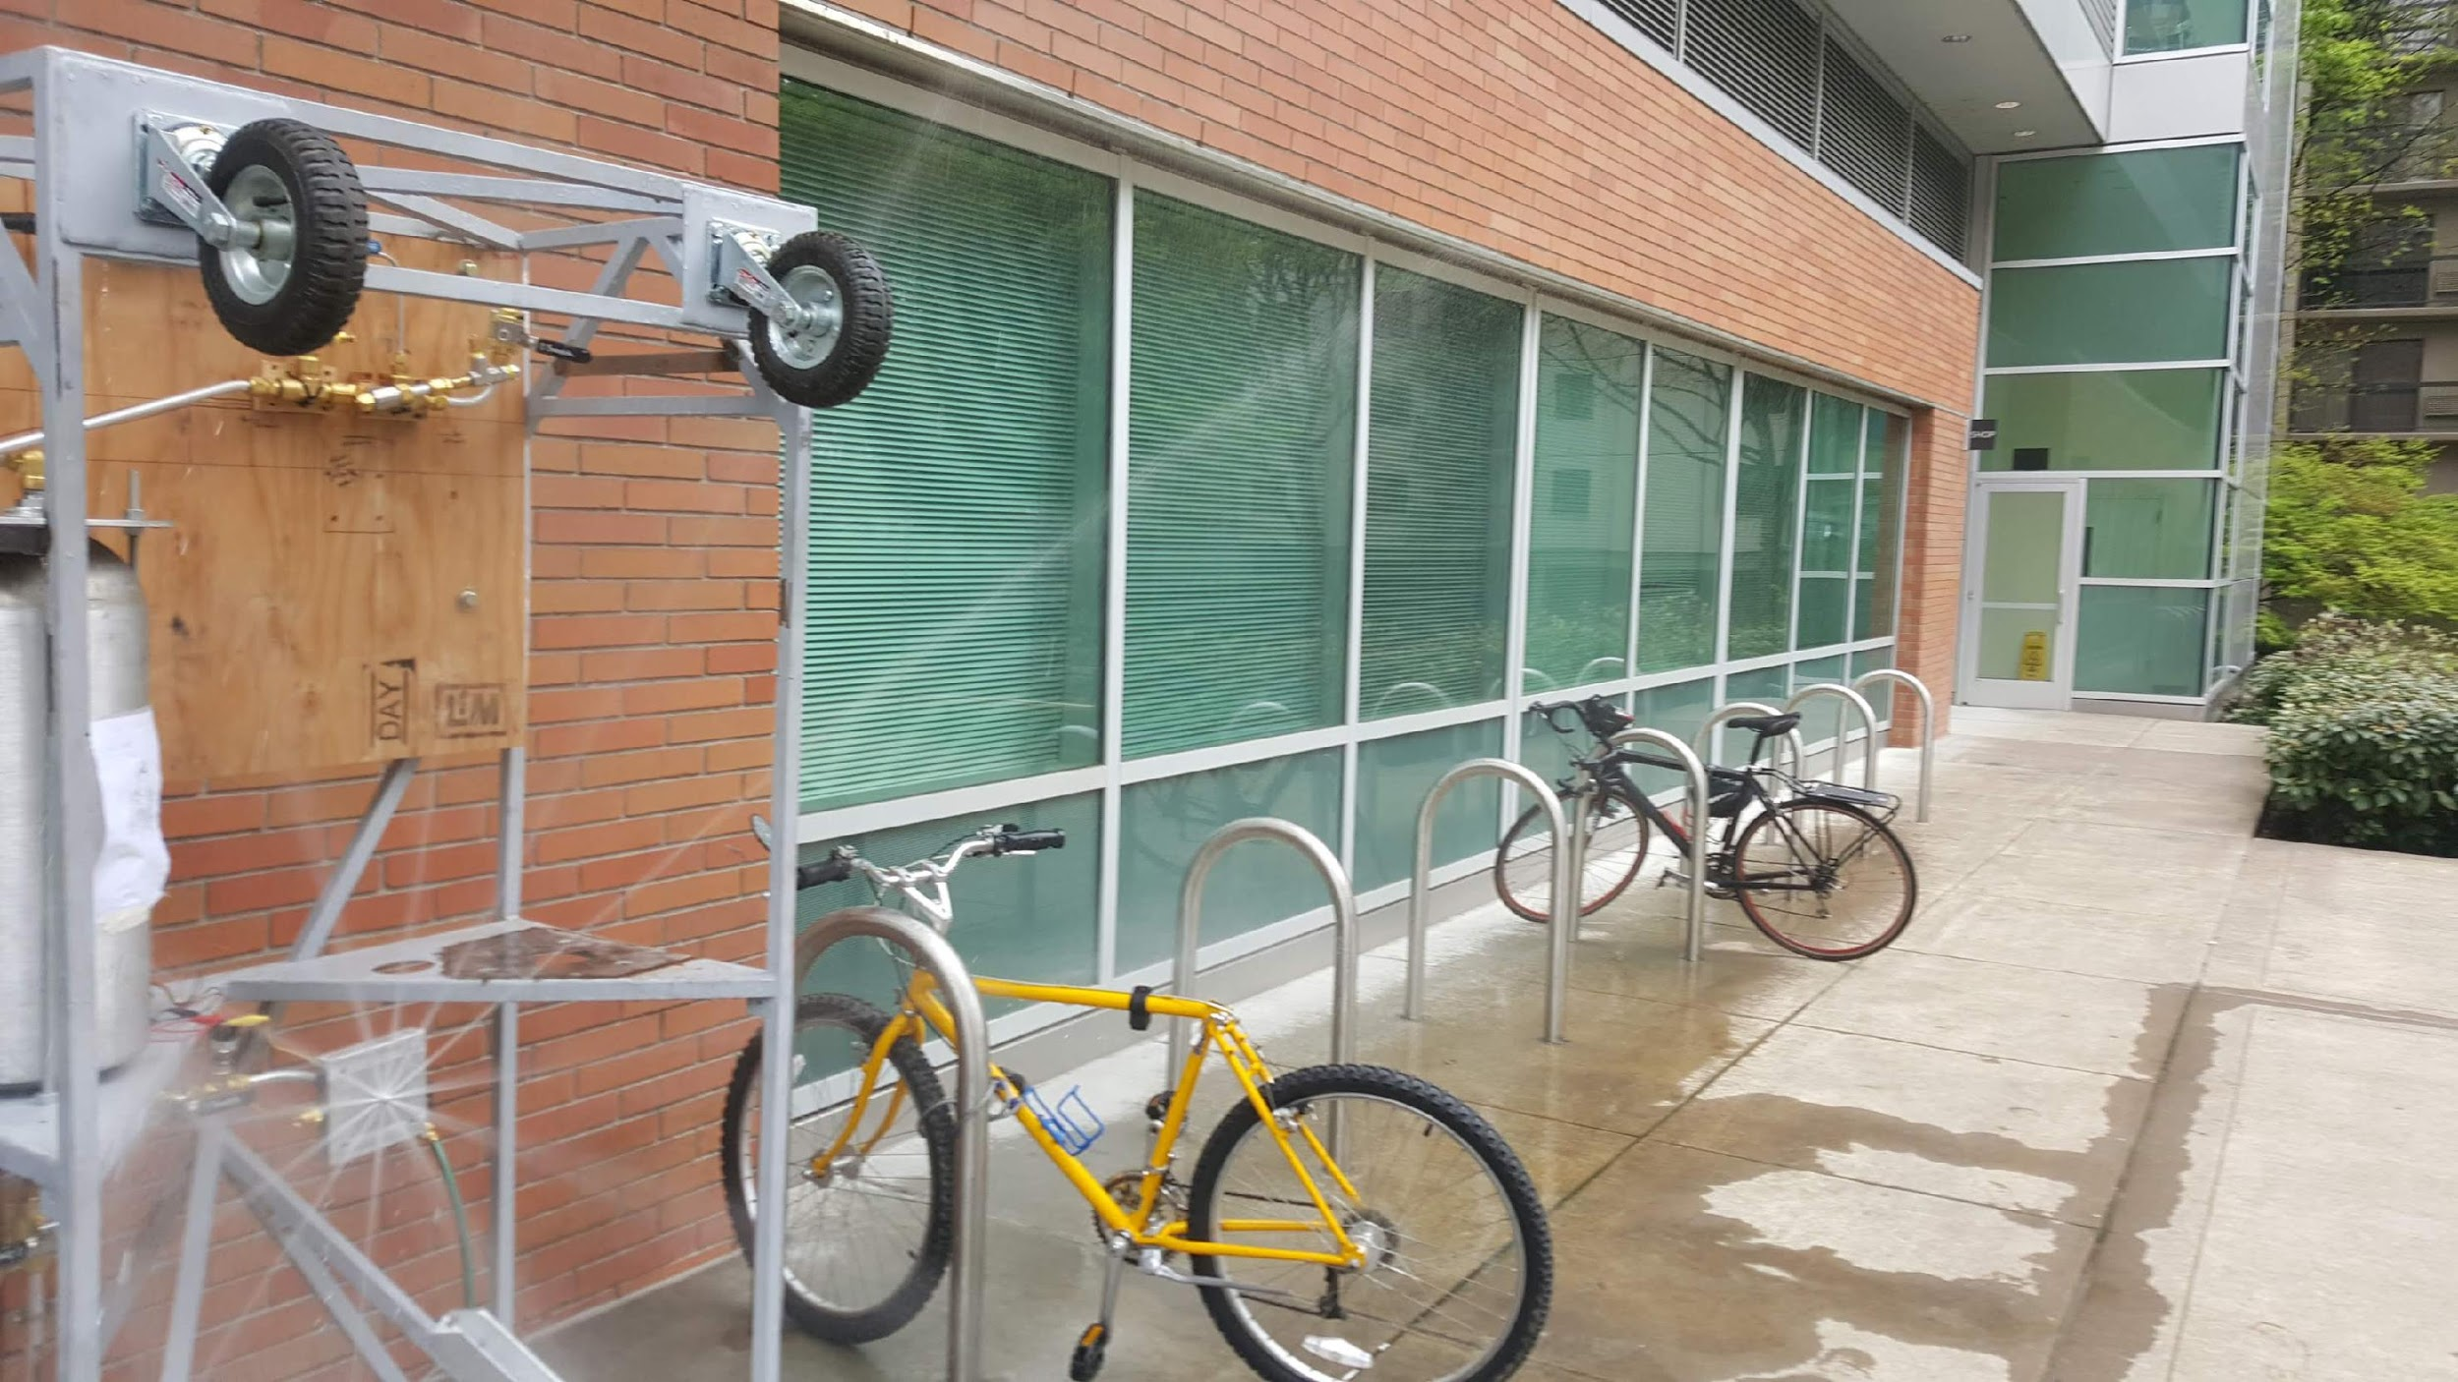
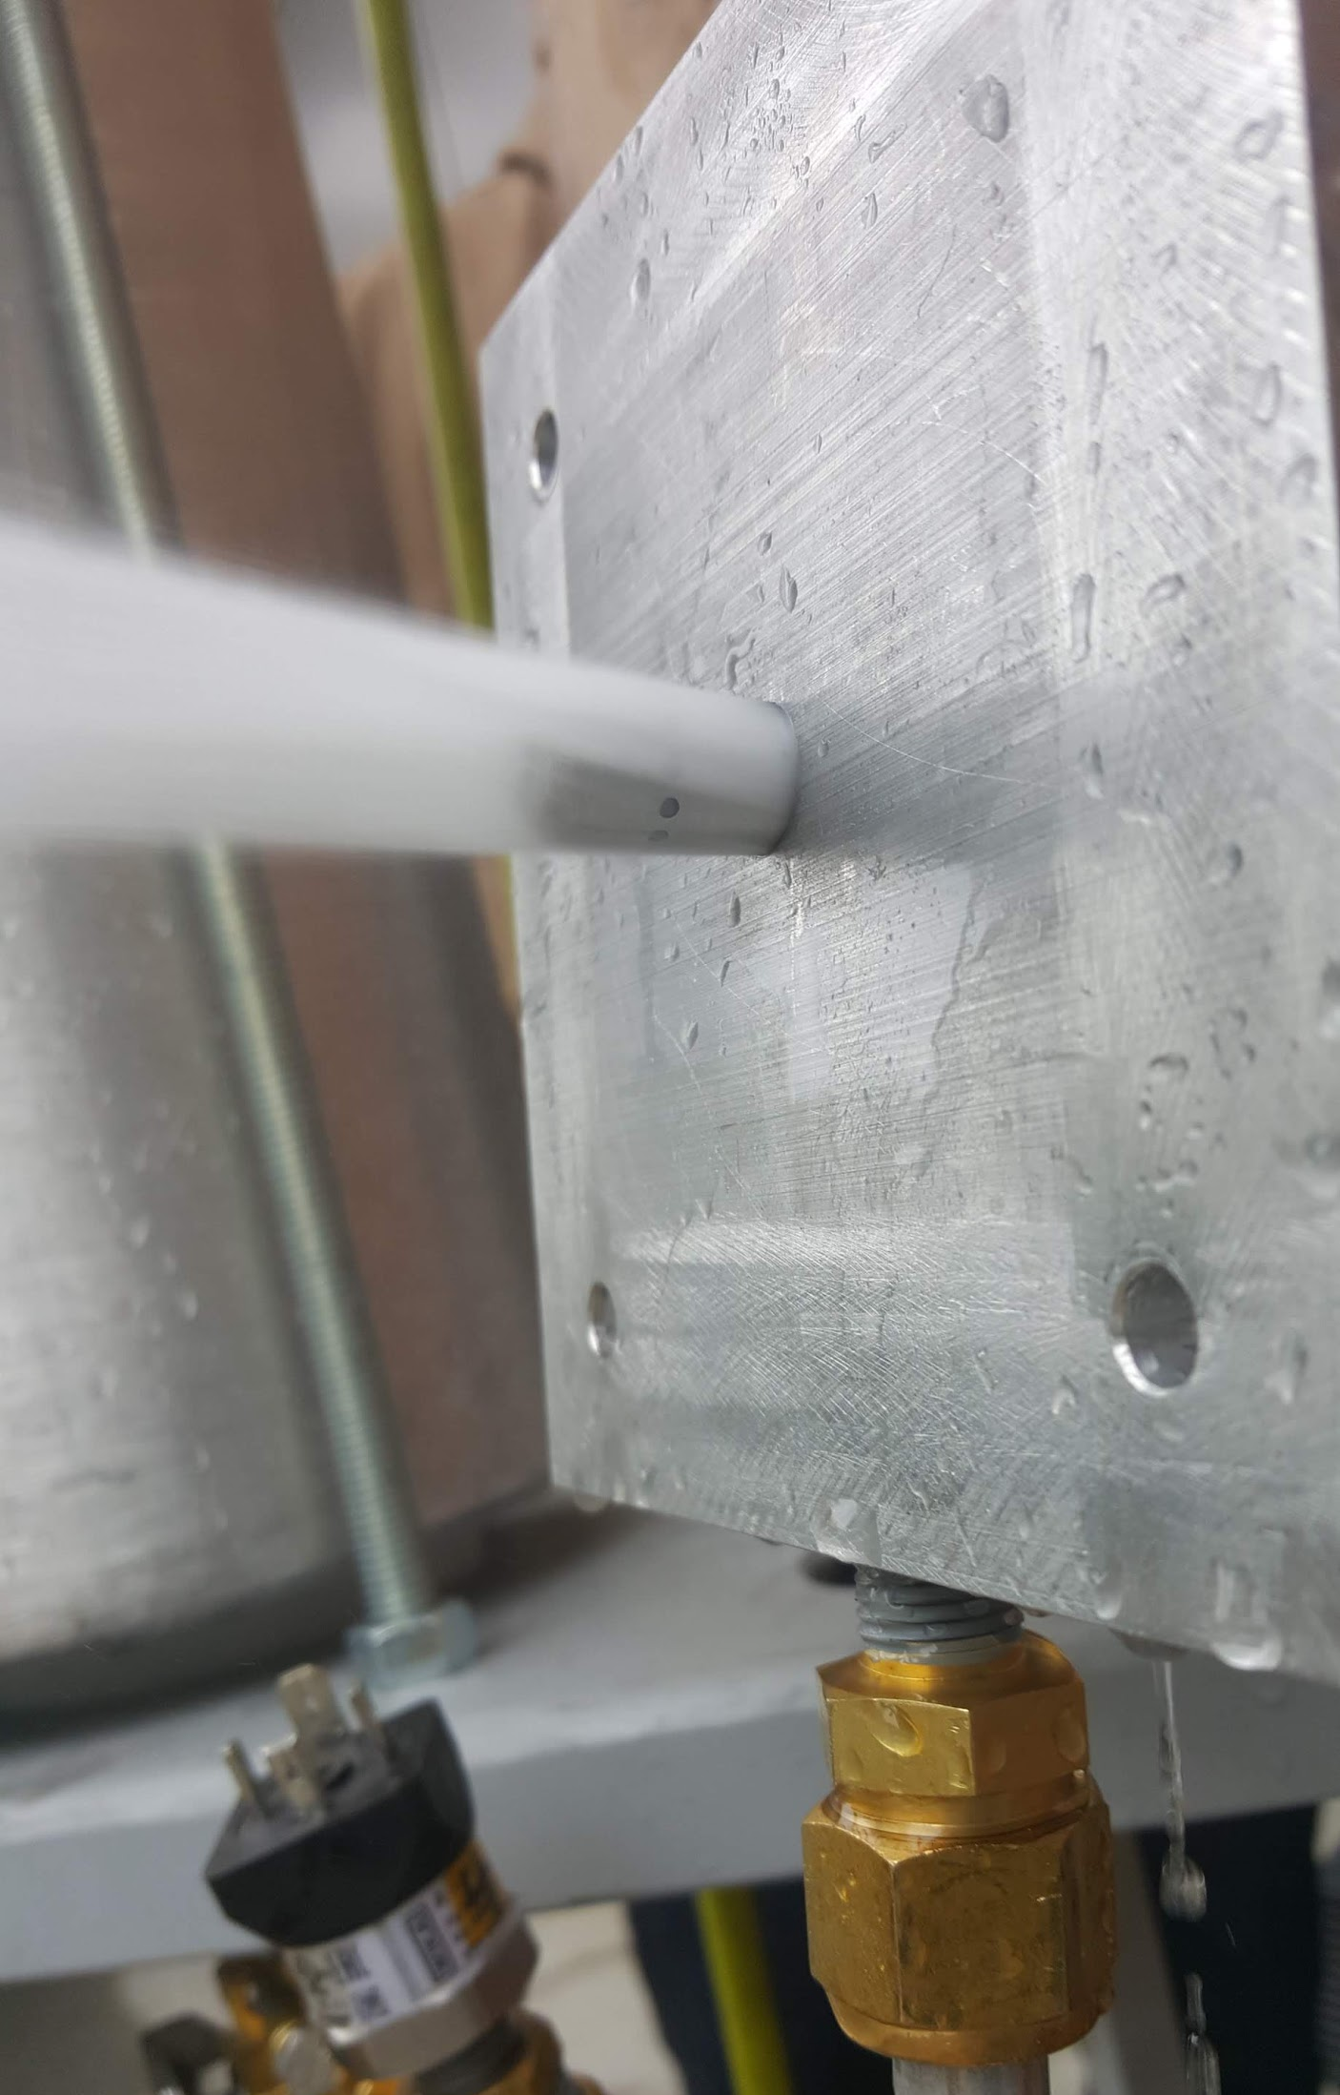
Pintle V2 Hydro Test
First round of hydro testing focused on pressure and mass flow rate
Flow through Annulus had concentricity issues...

Slide 17
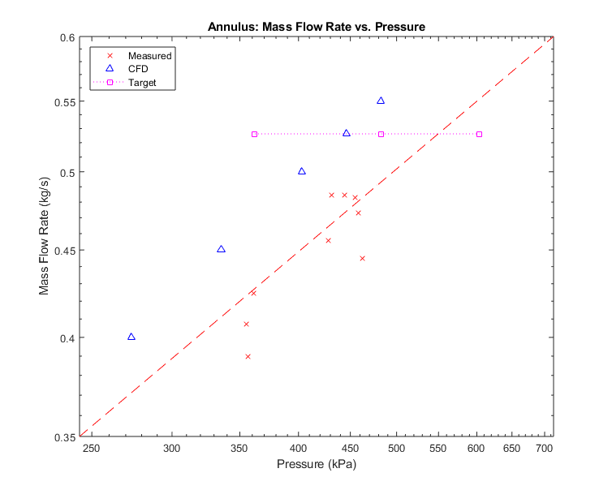
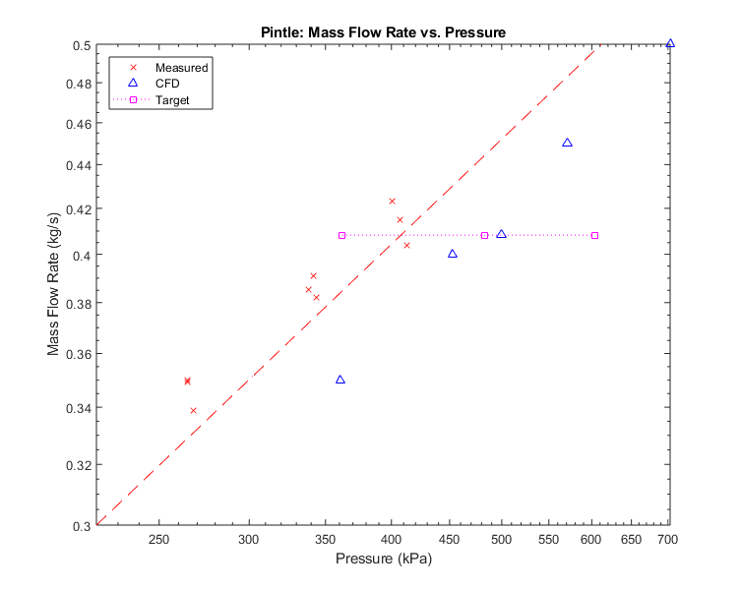
Testing Results
Both the Pintle and Annular flow rate curves met the engine requirements

Slide 18
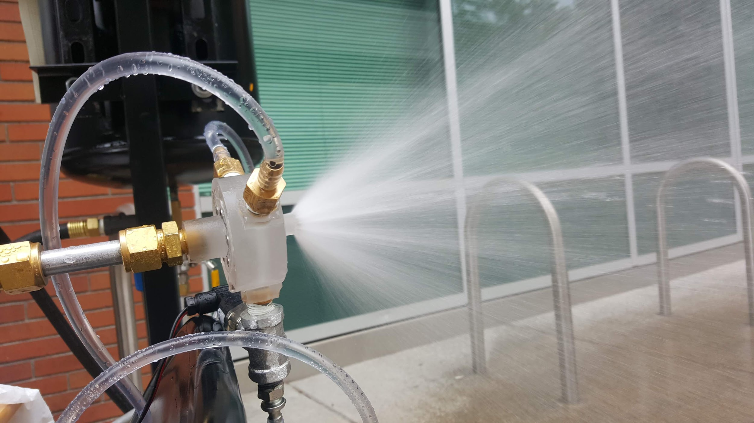
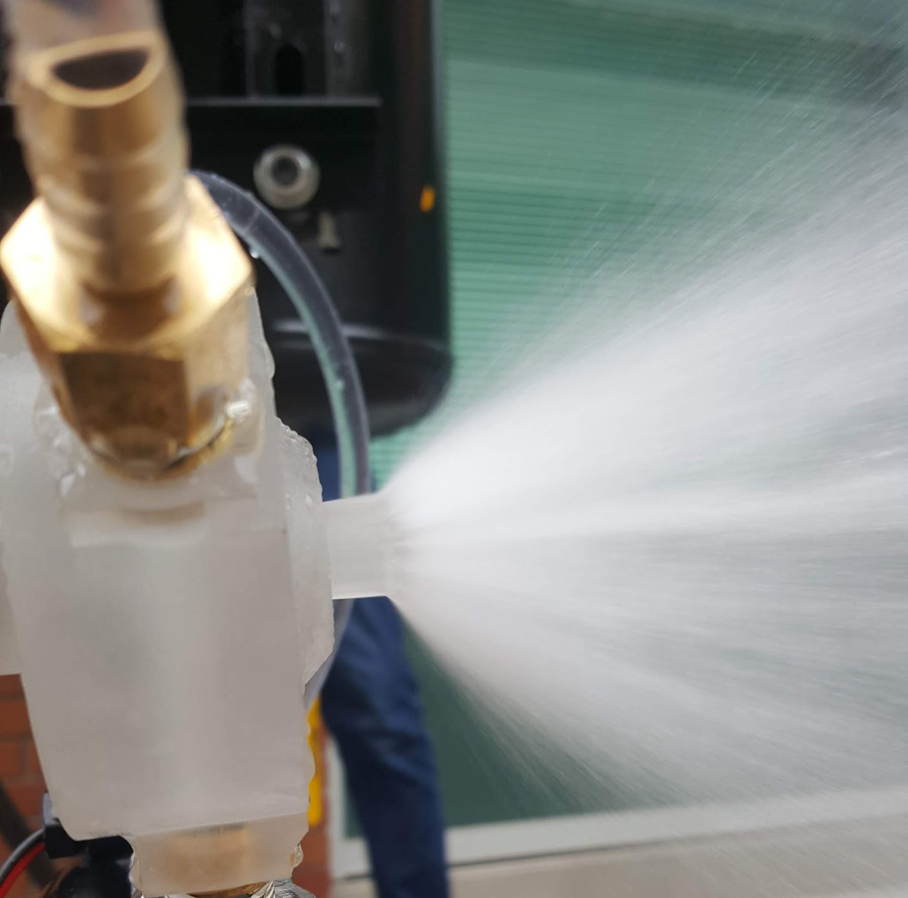
Pintle V3
New Annulus design improved flow concentricity
Spray angle requirement was met
Fine tuning still needed to meet mass flow rate and spray angle requirements simultaneously
Full theory and design documentation being turned over to PSAS

Slide 19
AM Engine Results

Slide 20
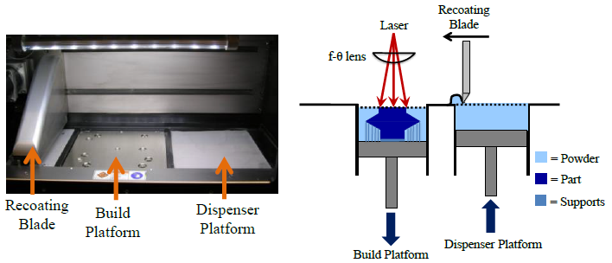
Direct Metal Laser Sintering (DMLS) process
https://3dprint.com/67882/sigma-labs-eta-3d-print/

Slide 21
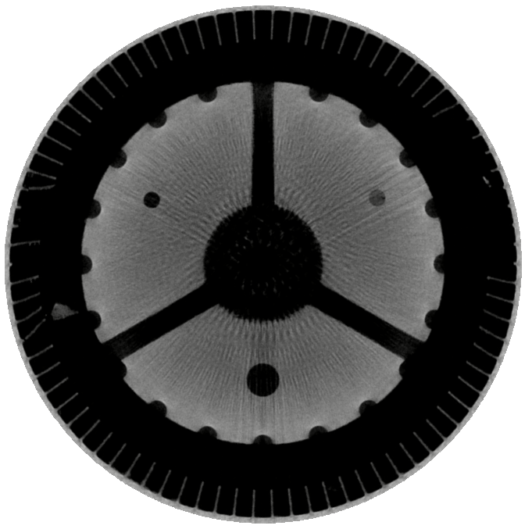
CT scanning donated by:
Delphi Precision Imaging
Recoater direction of travel

Slide 22
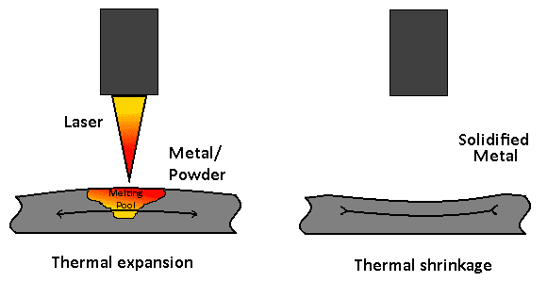
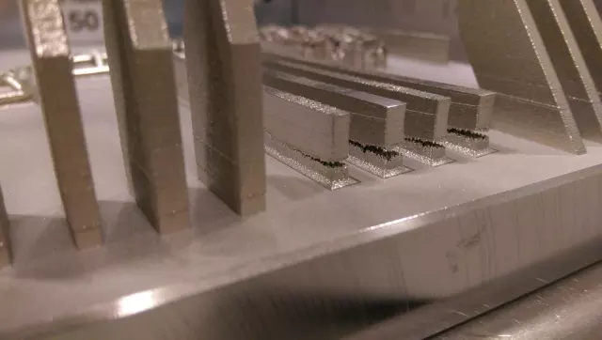
DMLS considerations
Tolerance
Residual stress
Machines/ runs/ and bed location have varying results
Anisotropic
NDE
Interfaces will require machining
http://3dprintingsimulation.blogspot.com/2016/04/simulation-of-thermal-stresses-during_6.html
https://www.engineering.com/3DPrinting/3DPrintingArticles/ArticleID/15202/7-Issues-to-Look-Out-for-in-Metal-3D-Printing.aspx

Slide 23
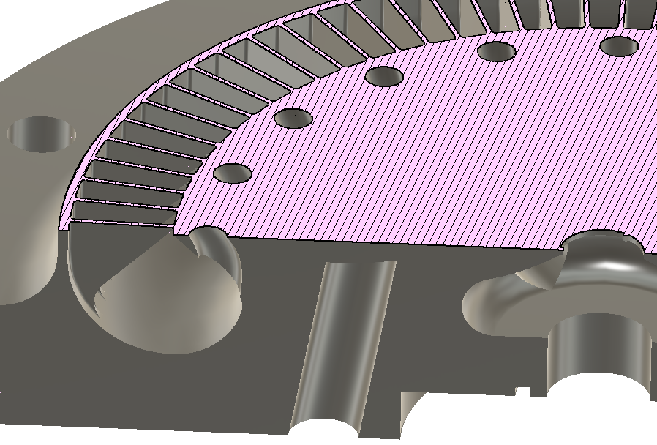
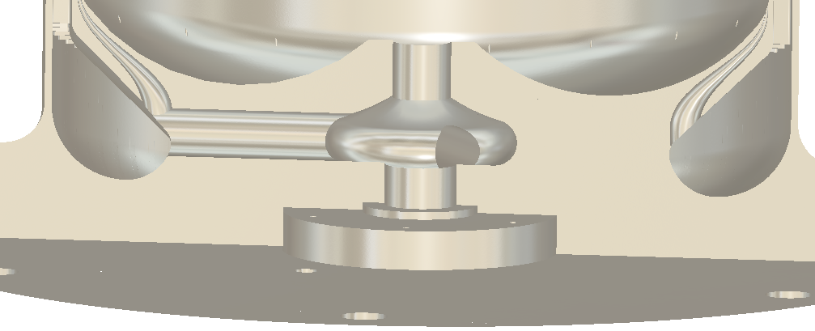
BEFORE
Simple CAD changes for better manufacturing
AFTER

Slide 24
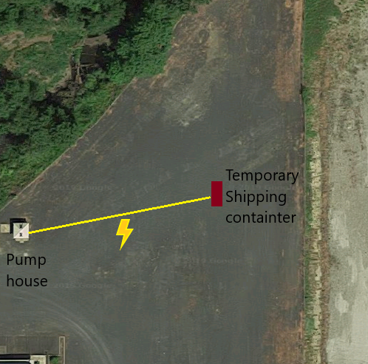


Location Decisions
What the potential test site could have looked like until it was determined that the area was filled with reclaimed asphalt.

Slide 25
Documentation
Now producing documentation such that the next capstone can progress.

Slide 26

[To regenerative-cooling]: “I’m sorry, little one.”
Notes:
Created 15 Oct 17

Slide 27
Questions?
Notes:
Created 15 Oct 17

